Slide 1
Capstone Project
World Bank Global Education Analysis

Slide 2
Content
Analysis based on:
Time zone
Country
Region
Trends:
Average Literacy rate
Average enrolment rate
Predicted mean years of education
Education in India:
Male , female literacy rate
Youth, adult , elderly literacy rate
Male, female enrolment rate
Challenges
Conclusion

Slide 3
Problem statements
Analysis based on literacy rates in three time zones
Analysis based on Gross enrolment rates in three time zones.
Education analysis in India
Analysis based on future predictions

Slide 4
Data Summary
The data set contains information of 3665 indicators in 242 countries from 1970 to 2100.
Shape:
886930 rows
70 columns
Important indicators:
Indicators containing literacy rates of different age groups
Indicators containing gross enrollment ratio of different age groups
Indicators containing mean years of schooling of different age groups

Slide 5
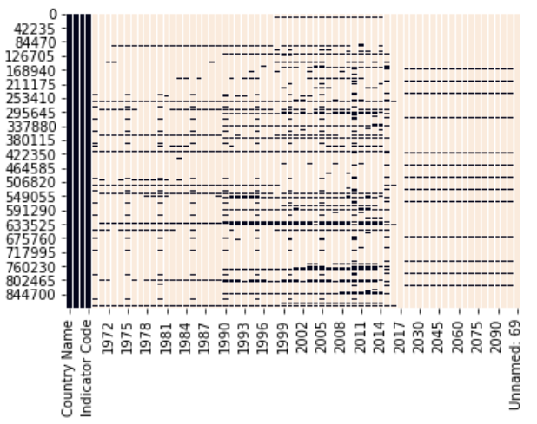
Null values in the data set

Slide 6
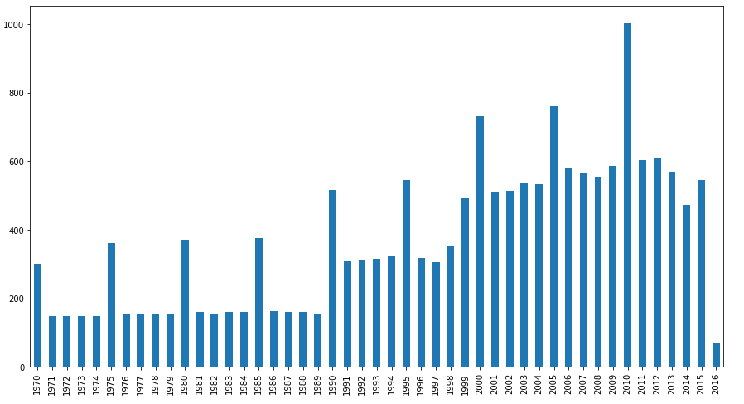
Average number of Indicators reported each year

Slide 7
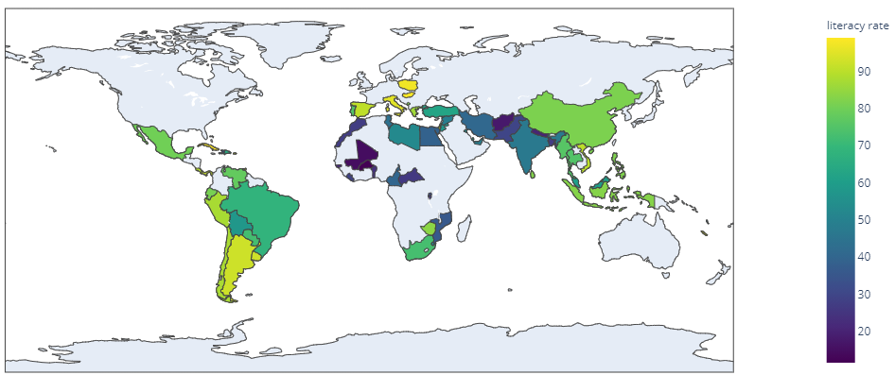
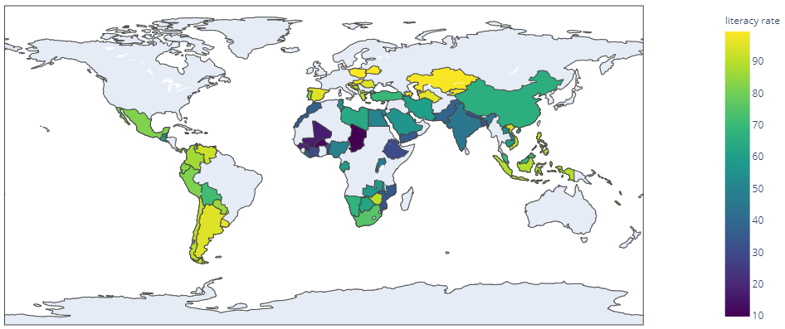
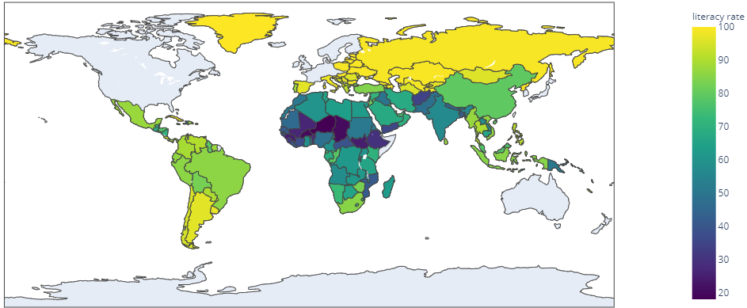
Literacy rate analysis in %
1975-1990
1990-1999
1999-2015

Slide 8
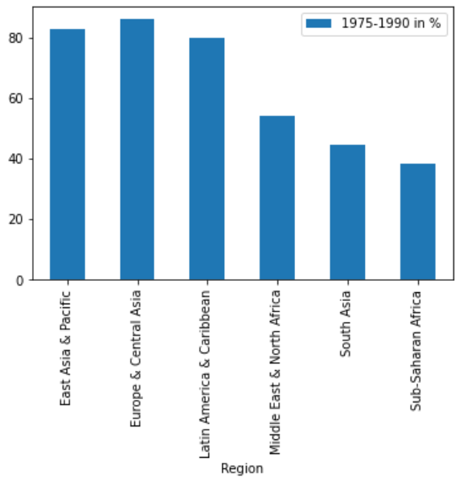
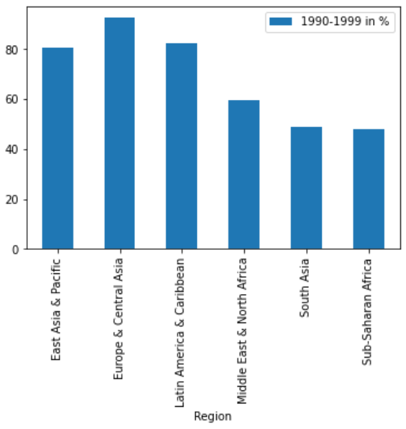
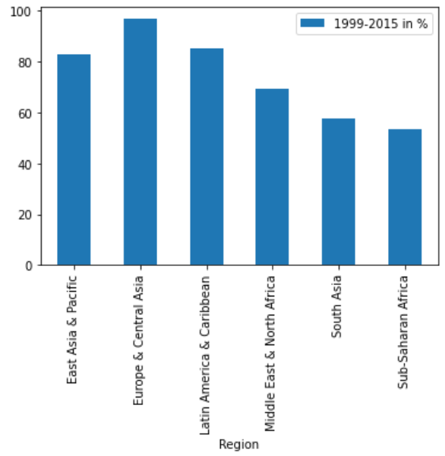
Region wise literacy rate analysis in %

Slide 9
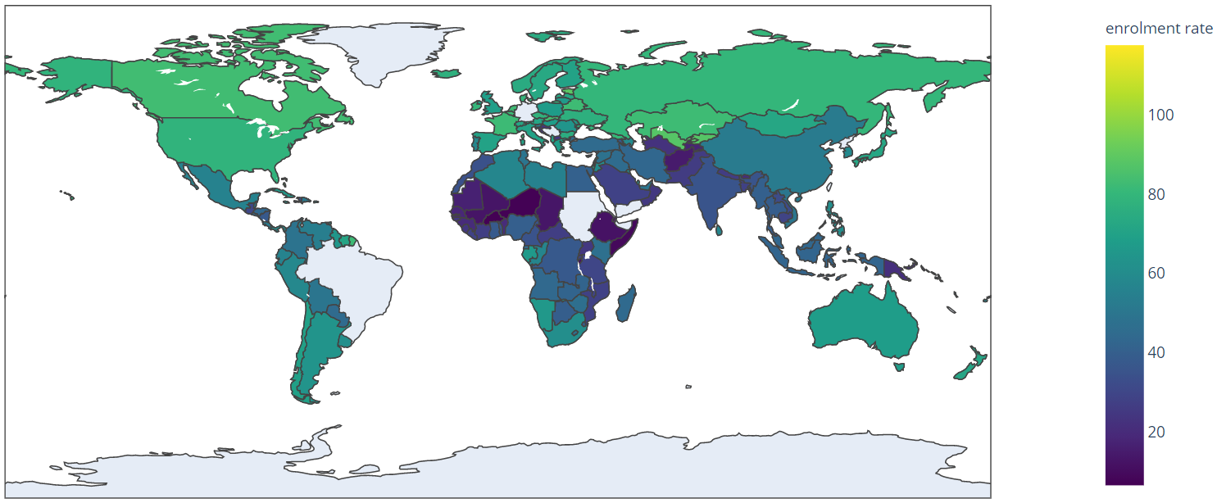
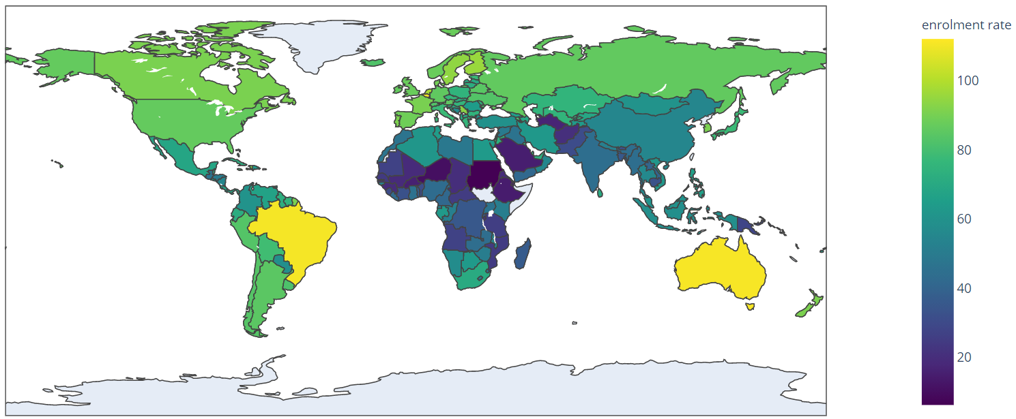

Enrolment rate analysis in %
1970-1990
1990-1999
1999-2015

Slide 10
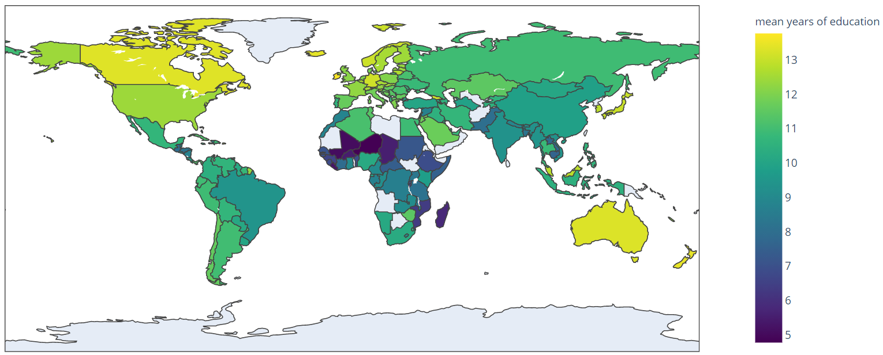
Future analysis
2020-2100

Slide 11
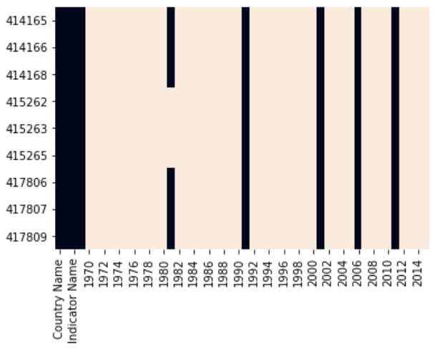
Education analysis in India

Slide 12
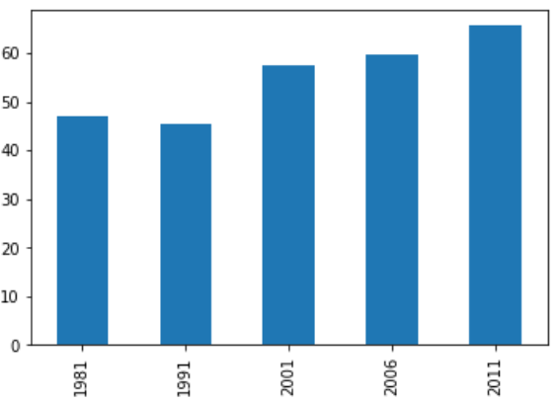
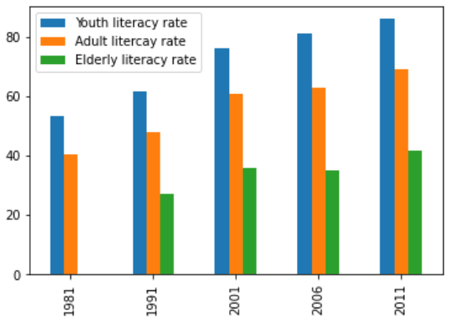
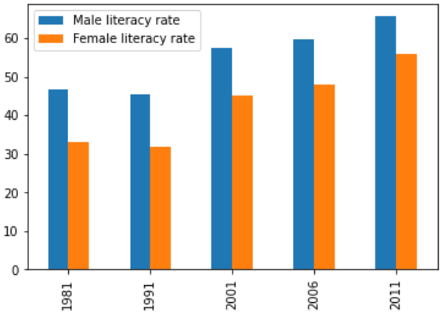
Literacy rate analysis in India
Youth, adult and elderly aged literacy analysis
Male vs Female literacy rate
overall analysis

Slide 13
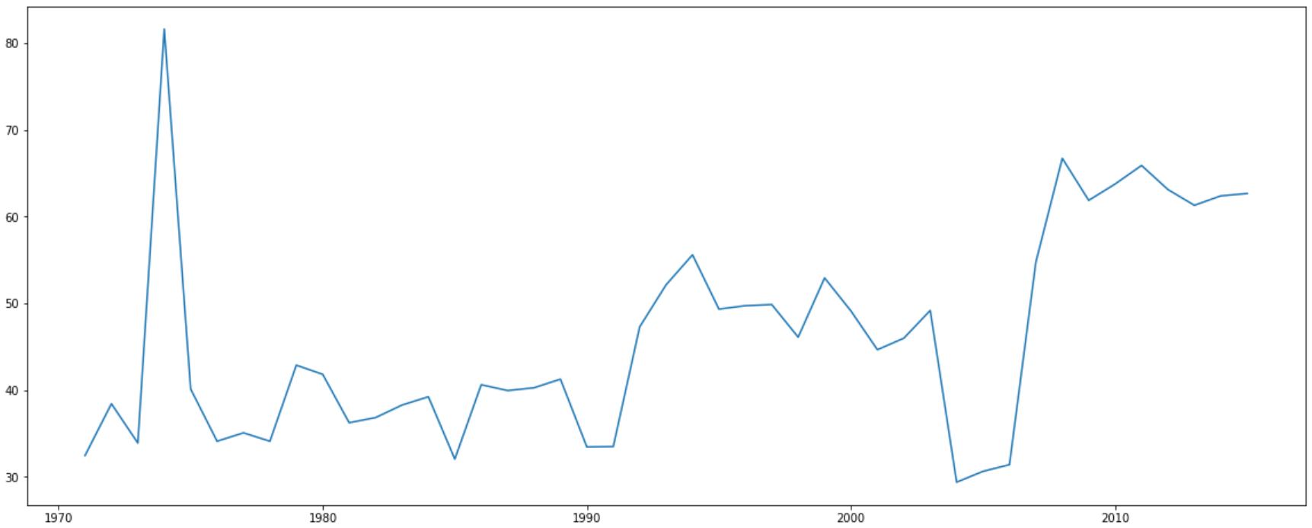
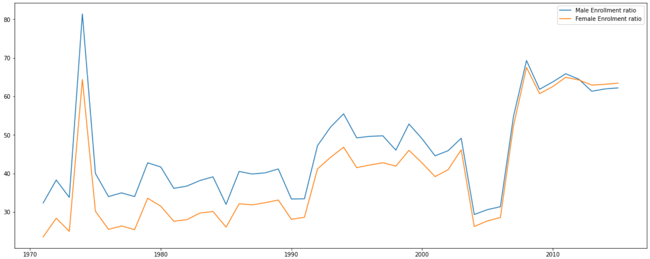
Enrolment analysis in India

Slide 14
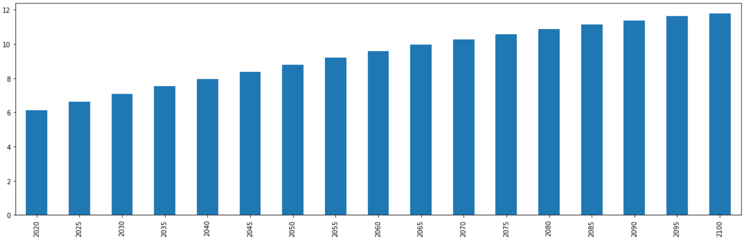
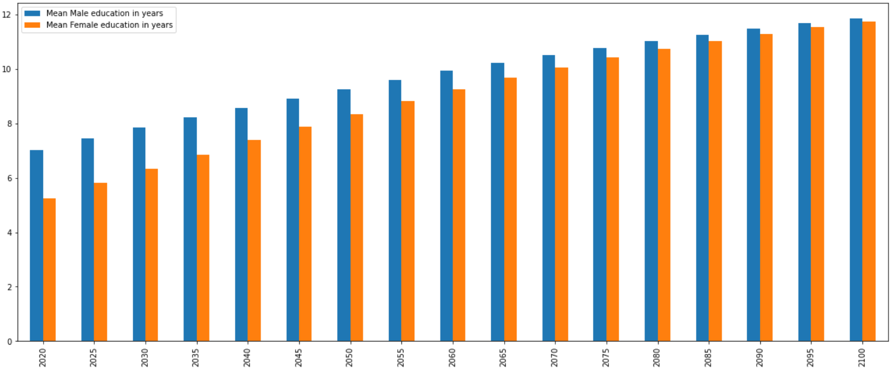
Analysis of future mean years of education in India

Slide 15
Challenges
Dealing with missing data
Identifying important indicators (among 3665) with non null values.
Plotting heat map of entire data is time taking.
Lack of data and irregular reporting.

Slide 16
Conclusion
We can see that Literacy rate is reported in less number of countries before 1999
Europe and central Asian countries reported highest literacy rates in all time zones.
Continuous increase in Enrolment ratio is observed in Central Asia and Australia.
Niger has least number of literacy and enrolment rate in all time zones.
Literacy rate in India has raised form 45%(in 1990-1999) to 57%(in 1999-2015).
Greenland has the highest literacy rate of 100% in the time zone 1999-2015.
Sub-Saharan Africa has the least literacy rate among all the regions.
Males have high literacy rate compared to females in India.

Slide 17
Teammates:
Satish Chandra Katikala– ksatish@iitg.ac.in
Raavi Sowmini Chowdary – sonysowmini@gmail.com

